Slide 1
Researching The Impact of Information Technology Companies On Cities By Uncovering Demographic And Business Data Trends
Is Big Tech good or bad for your city?
Leo Santos, Mike Borrero, Chris Flint, Chris McAleer, Desiree Ferrer

Slide 2


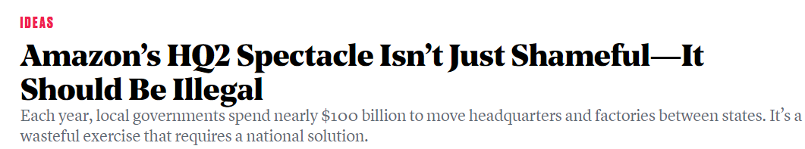


In Light Of The Recent Debate Over Amazon’s New Headquarters, We Asked The Question: Is Big Tech Good Or Bad For Your City?

Slide 3
Questions & Data
Hypothesis
Big tech companies can have an effect in home values, business
development and cost of living, especially for non-tech employees
Questions
What is the impact of home values and rent prices, business development, median household income, employment growth, and education in Big Tech cities ?
How does this compare to non-tech cities?
What is the impact for non-tech employees?

Slide 4
Data Sources
Census API - Demographic information
Google geolocation API (docs here)
Zillow - Home Values (www.zillow.com/home-values)
Bureau of labor and statistics(www.bls.gov) - Employment
Bureau of Economic Analysis (www.bea.com) - Employment
City Comparison
San Jose - Sacramento
Seattle - Portland
Austin - San Antonio

Slide 5

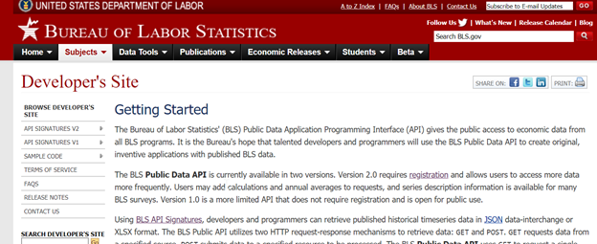
Data Sources (Exploration)
#1 Bureau of Economic Analysis (www.bea.com)
BEA has a free API; after some discovery, we did not find options for slicing income by city & industry. This data source is rather focused on the bigger picture. We moved on to other sources.
#2 Bureau of Labor Statistics “www.bls.gov”
We found it has many of the requirements we were looking for.
API had baseline (limited) documentation, but did not have much info available on data capabilities.

Slide 6
Data Sources (Exploration) - Cont’d
#3 Census API
Pulled data from Census API for population, education, housing, and employment
#4 Zillow Home Value Index
Zillow tracks home values per month since 2009 through the month before the current month. This data accompanies some visualizations on their website in csv and xls format.
#5 Google geolocation API
This API provides geocoding and reverse geocoding of addresses.

Slide 7

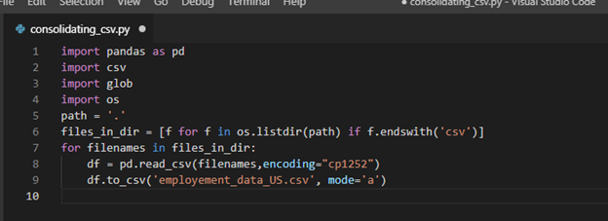
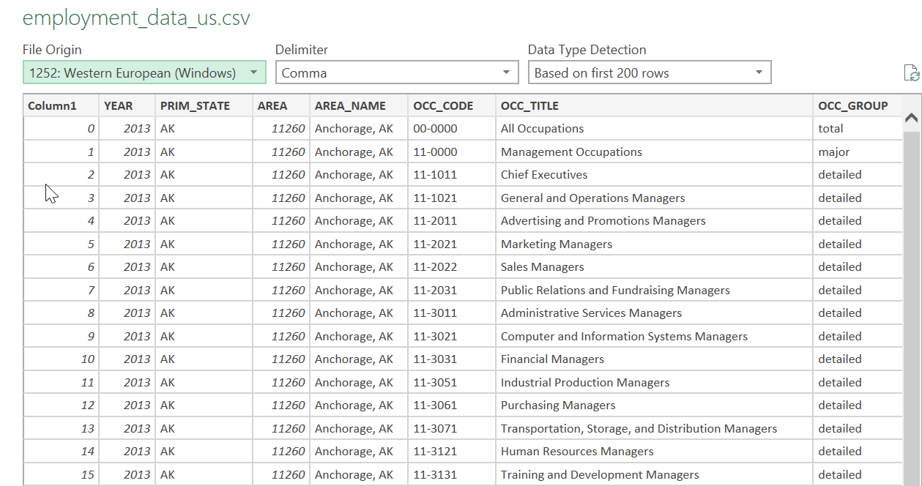
Issues During Data Exploration
Bureau of Labor Statistics
For discovery, it was necessary to download CSV version files. After some back and forth and even installing BLS’ python module.
After few hours and dozens of CSV’s downloaded, decided it was rather easier to work using CSV files than from API.
We used a nice python code for concatenating files. Also, we added a column and corresponding year for our working file.

Slide 8
Issues During Data Exploration
Zillow Information
We first tried to use the Zillow API to receive our information, but we could not find data for home prices by month. The API provides graphs that show changes in home value, but the graphs are difficult to read and they are not accompanied with data, so we decided to try different API’s. I then contacted a few, and while there was lots of data, I did not find anyplace that had it broken down by month.
We then decided to search online for the exact data we needed, and we were lucky to see that on Zillow’s website they provide large excel files for all the data used to make their own visualizations. We decided to download and use this data. Google Geolocation API
We did not have many issues during data exploration using the google API. The only minor thing I had to do during data exploration was figure out how to search the api using large metro areas made up of 2-4 towns/cities, instead of simply using the city names because this is how the Zillow Data was structured. This was an easy fix though.

Slide 9
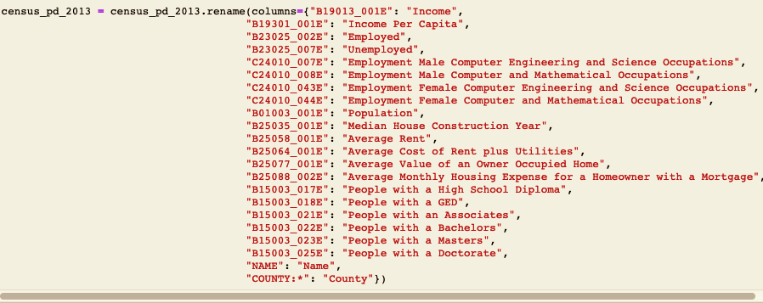
Issues During Data Exploration
Census API
Finding data in Census API for each city, because it only lets you search for zip codes or counties
Cleaning such a large dataframe. Trying to import too many columns, when we should have focused on the ones we actually needed from the start.

Slide 10
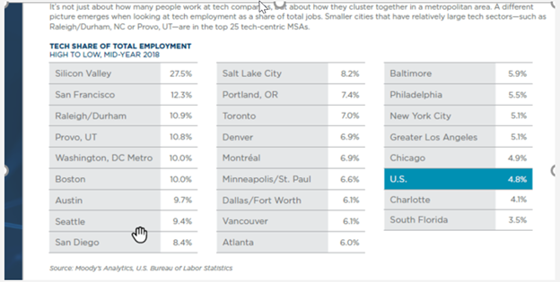

Data Cleanup
Data on US cities by industry
Data overlay segments:
Cities: Areas where tech industry has a high share compared to the rest of the country.
Tech-city report by Moody’s: found target cities/areas to explore; then, compared those areas with a relatively similar city in similar area, with lower tech share.
Tech industry. found list of occupation codes of what is considered the “tech industry”. listed as OCC-codes from the Department of Labor.

Slide 11
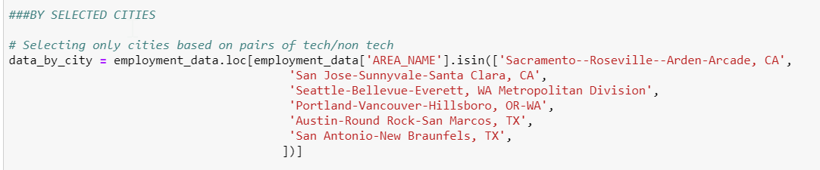
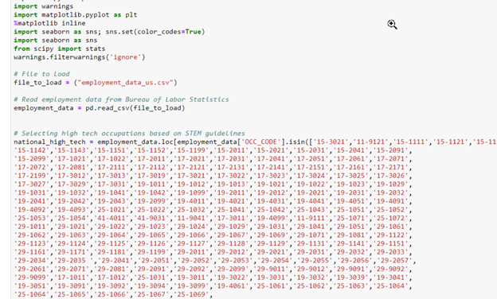
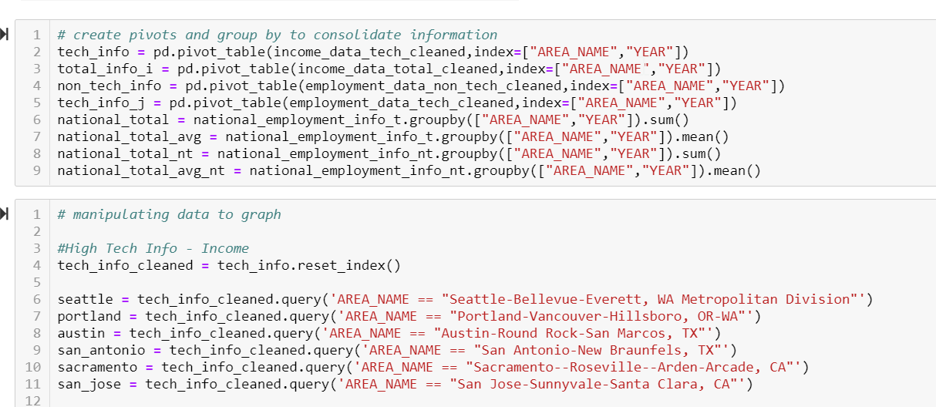
Data Cleanup - Cont’d
Filtering
.isin [Filter multiple values]
~ negation [complement]
.loc .query [filter by values]
Grouping
.pivot .groupby

Slide 12
Data Cleanup - Cont’d
Zillow data
The zillow excel sheets provided excel files with the overall home value mean by month from 2009- until the month before last. The files contain the mean for the entire city as well as for each individual neighborhood. The first step we took was to separate all the of the entries for each city (and drop the neighborhood entries) and combine them into one dataframe. Next, we had to remove the columns for the years before and after our sample time period, 2013-2017.
We then took the data and calculated the change in growth, by percent, for each city, and combined this data into a small dataframe.
Google Geolocation API
The main data clean up we had to for this api was editing the metro area names in the excel sheet so that we could loop through them and send the names to the API in the proper format. We then used the API to calculate the distances between cities, and built another dataframe that displays the percentage change between randomly selected pairs of cities.

Slide 13
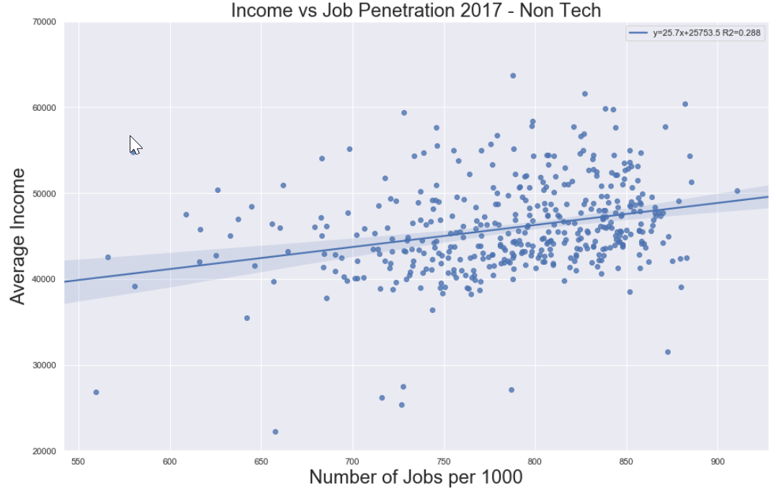
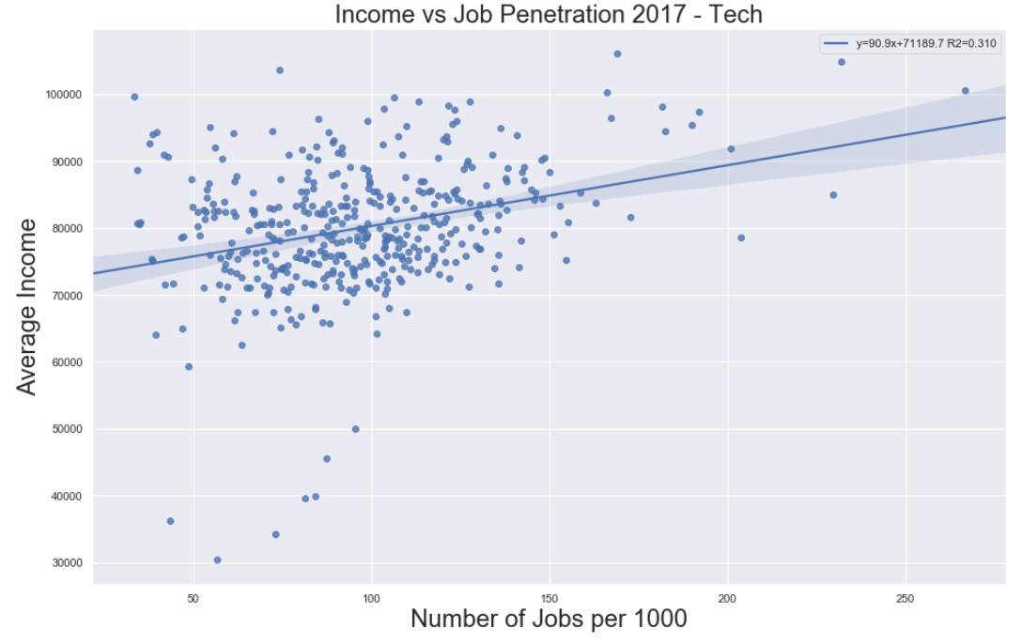
General View Tech vs Non-Tech
Mean Income / Jobs per 1000
General view on income of top US cities
Tech Mean Income (2017): $79,958
Non Tech Mean Income (2017): $45,963.
Tech industry shared is narrow in most of cities with few cluster having >25% saturation

Slide 14
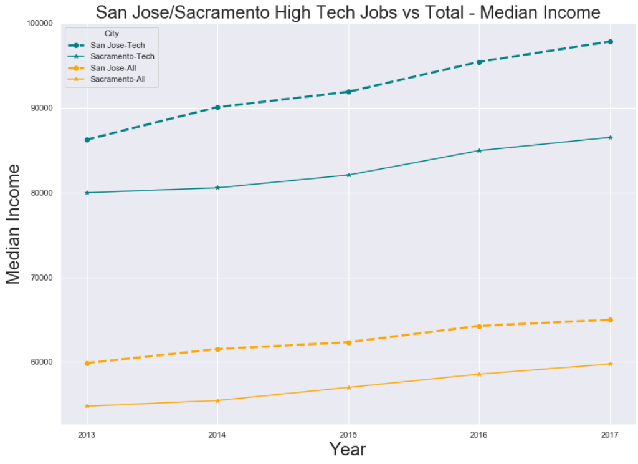
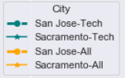
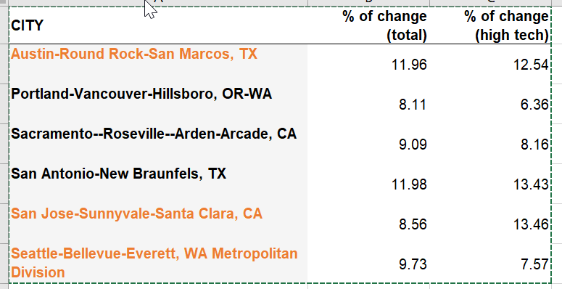
Tech Income vs General Income
San Jose, CA | Sacramento, CA

Slide 15
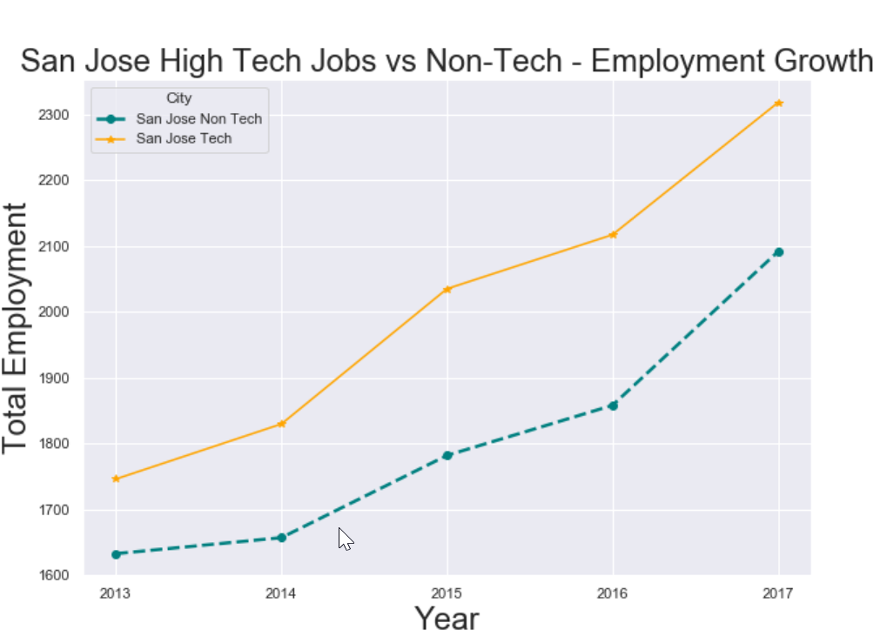
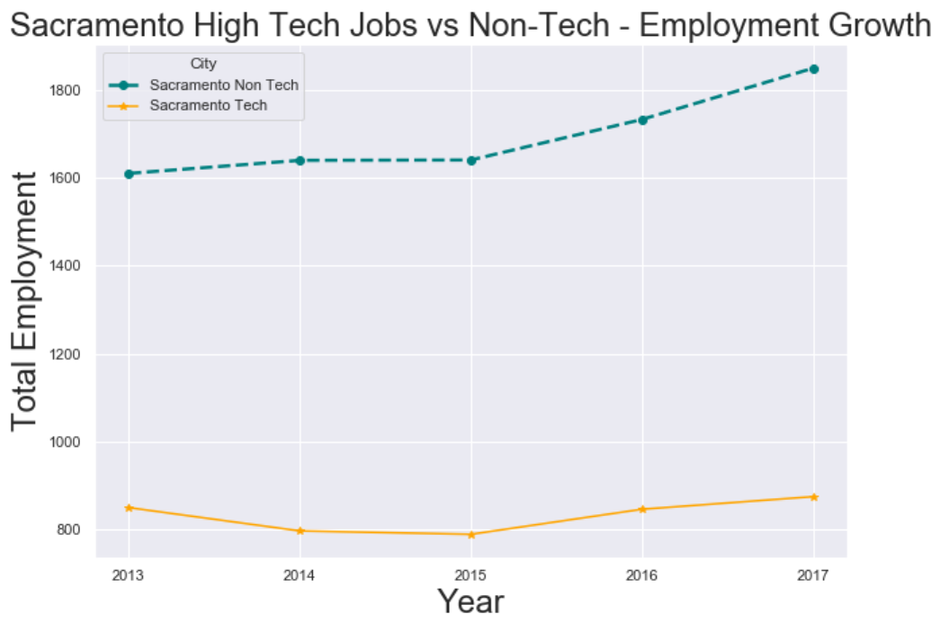
Employment Growth (Tech vs Non Tech)
San Jose, CA | Sacramento, CA
Sacramento Tech 2.94%
849- 2013
874- 2017
Sacramento 21.95%
1632 - 2013
2091 - 2017
San Jose Tech - 32.77%
1745 - 2013
2318 - 2017
San Jose - 28.12 %
1632- 2013
2091 - 2017

Slide 16
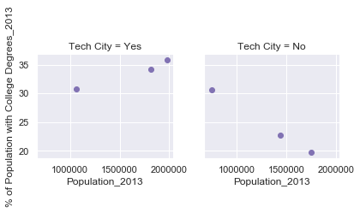
Percent of Population with College Degrees vs Population (2013)
Avg Percentage of population in Tech cities with college degrees: 33.64%
Avg Percentage of population in Non-Tech cities with college degrees: 24.35%

Slide 17
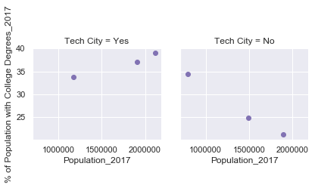
Percent of Population with College Degrees vs Population (2017)
Avg Percentage of population in Tech cities with college degrees: 36.67%
Avg Percentage of population in Non-Tech cities with college degrees: 26.80%

Slide 18
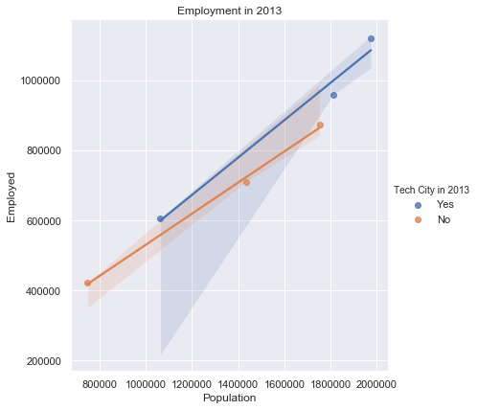
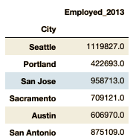
Employment for Tech and Non-Tech Cities
-2013-

Slide 19
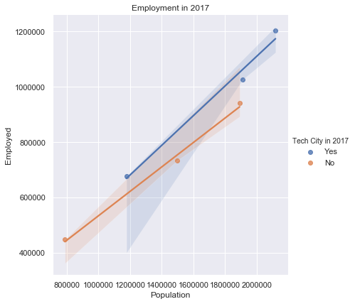
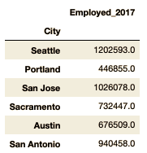
Employment for Tech and Non-Tech Cities
-2017-

Slide 20
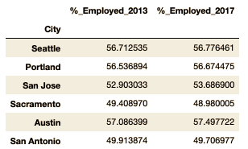
Percent Employed for Tech and Non-Tech Cities
Cities employment percentage stayed relatively the same over the years
Two cities employment percentage dropped over the years. Both were non-tech cities

Slide 21
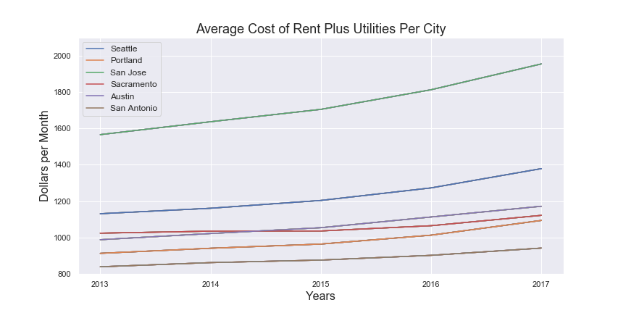
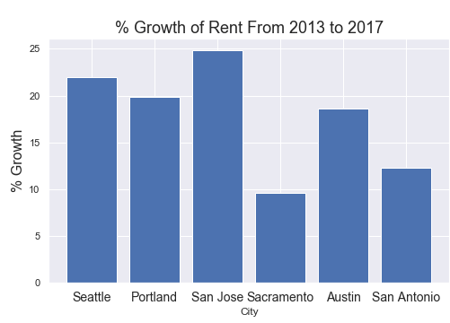
Tech Cities (San Jose and Seattle) Have the Highest Average Cost of Rent and the Greatest % Growth
Even if you rent, it is already expensive to live there and that expense is increasing at a larger rate!!! (might be hard to save for a house)

Slide 22
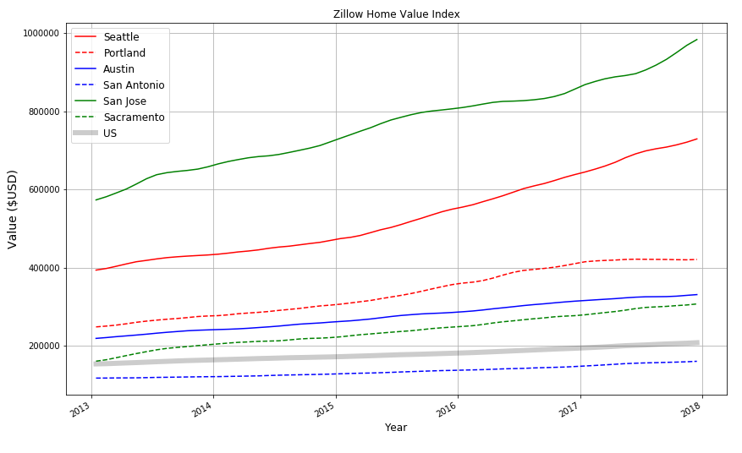
Tech Cities (San Jose and Seattle) Have the Highest Average Home Values
Buying a house in a tech city is expensive!!!

Slide 23
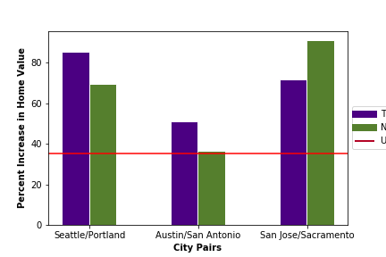
BUT, does that mean the percentage of growth is also greater for Tech cities?
When we looked past the average home value and analyzed the actual change in growth, we discovered that while the tech cities did experience significant growth, the non tech cities also experienced growth over the same time period that was significantly higher than the national average . In one case, the non tech city (Sacramento) grew significantly more than the tech city (San Jose).

Slide 24
How would these numbers compare to randomly selected pairs of cities?
At this point, our team began to wonder how these percentages would compare not only to the growth rate of the United States, but also how the difference in growth between the pairs of cities would compare to some randomly selected pairs of cities.
We assumed the most important factor when comparing growth between cities is the actual distance between them; ie the closer two randomly selected cities are geographically, the more their growth should correspond.
In order to see how are city pairs compared, we used the geolocation api to randomly select 20 pairs of metro areas within 175 miles of each other (our max distance between our city pairs) and we plotted the data on a scatter plot.

Slide 25
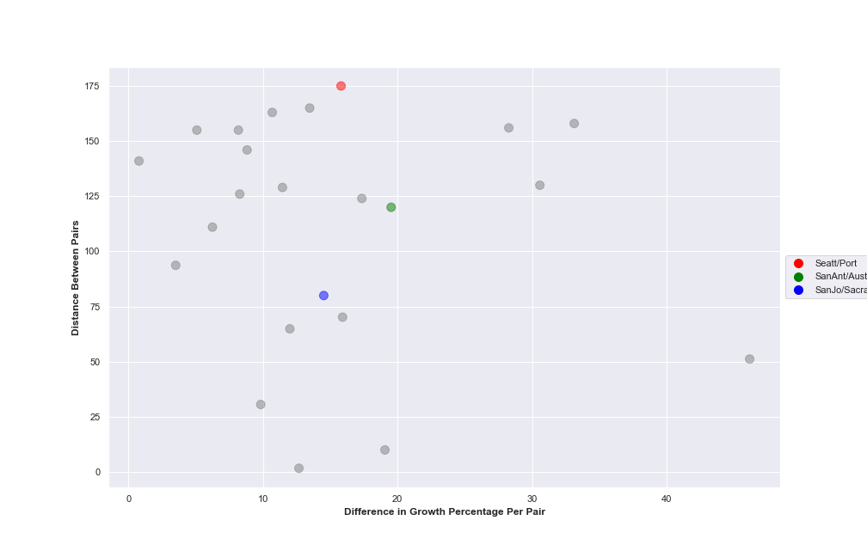
How would these numbers compare to randomly selected pairs of cities?
While the plot did not show an observable relationship between the pair’s distance and the difference in growth percentage , we did see that most of the data was plotted in one cluster, and all 3 of our pairs fell within the cluster. This tells me none of these values were outliers and the differences in growth were within a normal range when compared to the random pairs.

Slide 26
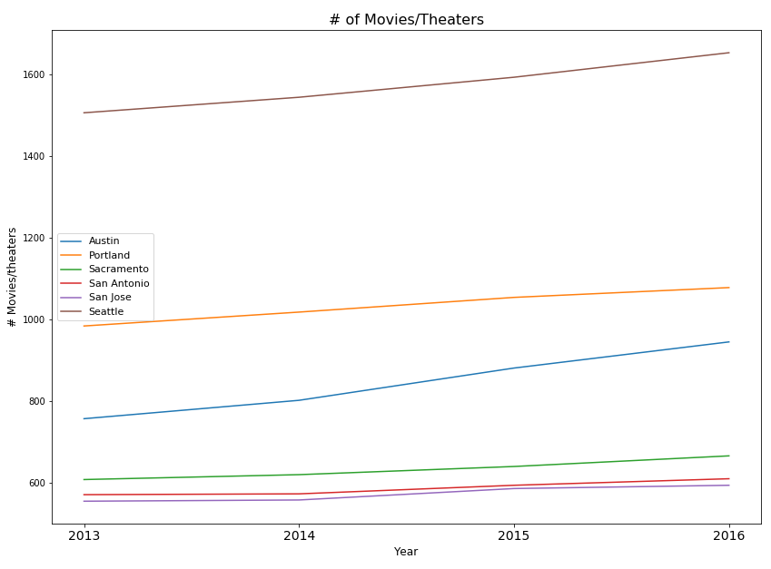
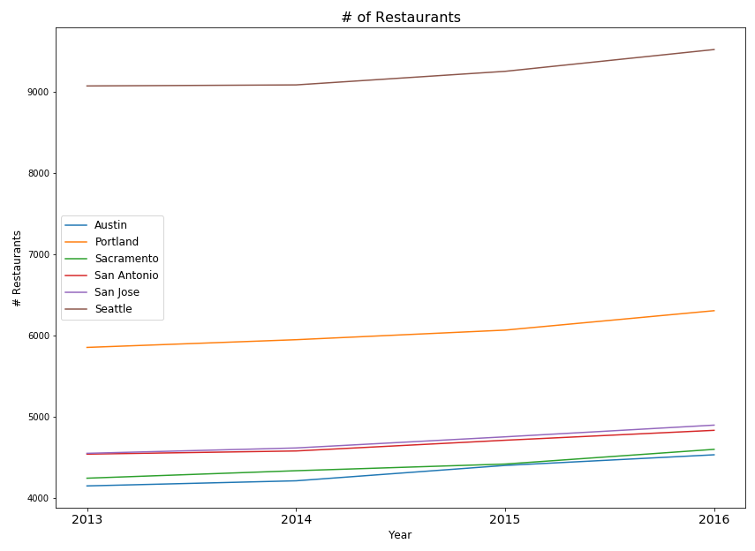
Entertainment and Night-life per City
If you can afford it Seattle does have many places where you can relax and unwind and perhaps take in a little culture while San jose does not

Slide 27
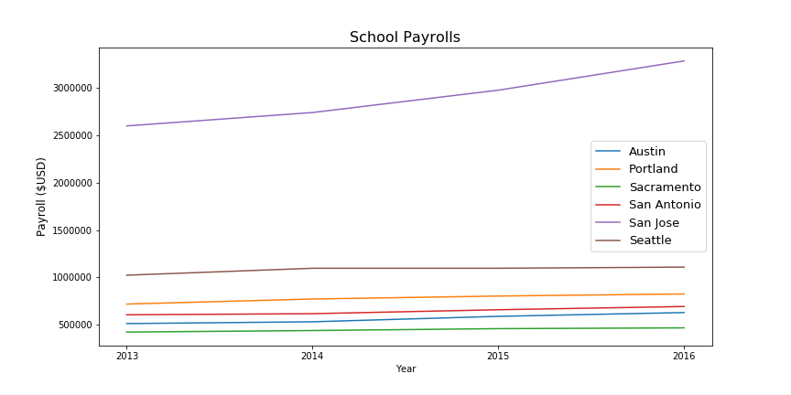
San Jose Spends A larger Amount on Education

Slide 28
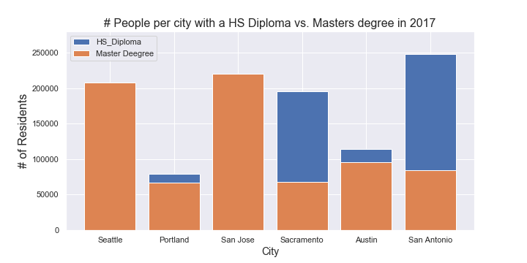
Something Unexpected I learned
In tech cities you are more likely to run into a person with a masters degree than with a high school diploma

Slide 29
Findings Summary
Did not find a conclusive evidence on whether or not tech is good for a city; however, we found interesting aspects worth noting.
Tech industry is relatively a small portion of jobs, yet it contributes with higher income wages.
Analyzing tech vs non-tech cities, we observed:
Non-tech income is usually higher in tech cities.
Tech cities have a larger percentage of the population with an associates degree or higher.
Both tech and non-tech cities saw an increase of the population with higher education.
Although there was an increase in the amount of people employed from 2013-2017, the percent employed based on the population stayed relatively the same.

Slide 30
Findings Summary
Based on the comparison of the city pairs we selected and the random pairs of cities we compared them to, it seems like the growth rate for tech cities is not substantially larger than the growth for comparable cities without large tech markets. The home values are considerably larger in the tech cities, but the values also started at a much larger average than the non tech cities.
If we had more time to continue this project, we would like to get a larger sample of tech and non tech city pairs. Perhaps we could use the top 10 tech cities. We would then like to sample a larger pool of randomly selected pairs of cities so we can be sure our findings are accurate.

